Slide 1
Human Activity Recognition
Niranjan Viladkar Under the guidance from Dr. Subhashis Banerjee and Dr. Parag Singla Department of Computer Science, IIT Delhi
M.Tech Project Presentation – November 29, 2013

Slide 2
Overview
Quick recap of theory and approach
Implementation done in this semester
Current Status
Problems faced

Slide 3
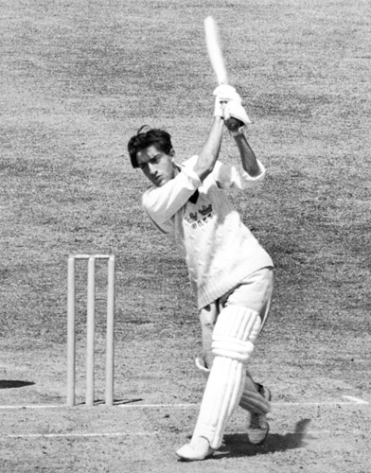
Recap - Problem Statement
What is Video Activity Recognition?
Play

Slide 4
Recap - Approach
Classification based on HoGHoF features
Probability of Objects using Object Detection
Probabilistic Inference Logic using MLN
Predictions

Slide 5
Recap - Classification using HoGHoF
Describe a video clip as bag-of-features.
Cluster all HoGHoF feature descriptors using k-means.
Represent clip as a histogram over these clusters
Train a classifier
Supervised - Dataset is pre labeled

Slide 6
Recap – Object Detection
Using Discriminatively Trained Deformable Part Models
Pre-trained object detector for 19 objects
aeroplane, bicycle, bird, boat, bottle, bus, car, cat, chair, cow, dining table, dog, horse, motorbike, potted plant, sheep, sofa, train, tv monitor

Slide 7
Recap - Relation between Activity and Objects
Probability of each activity given each object

Slide 8
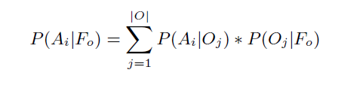
Recap - Integrated Activity Recogniser
P(A_{i} | F_{v}) – Calculated in 1st part.
P( A_{i} | F_{o} ) -
Gigaword Corpus
Object Detector

Slide 9
Recap - Morkov Logic Network
Inference using Knowledge – First Order Logic
Probabilities – Handle probabilities with FOL
Problems with Pure Logic and Pure Probabilities
MLN – Assign real valued weights to rules
Learn the weights

Slide 10
Implementation
Once STIP features extraction is done, we need to sample random features and cluster them using K-Means.
Two techniques for sampling –
Pick a random feature from all of the features
Pick a clip + randomly pick required number of samples from that clip
We chose second method.

Slide 11
Implementation
STIP features extraction and Clustering.
Bag-of-Features representation of video clips.
Using Euclidean distance of each feature from clusters, assign a feature to its nearest cluster.
Each clip is represented as a vector of length k.

Slide 12
Implementation
STIP features extraction and Clustering.
Bag-of-Features representation of video clips.
Learning a model
We use libsvm
Scale input data before learning

Slide 13
This Semster
STIP features extraction done.
Clustering – k-means clustering integrated in pipeline.
Bag-of-Features representation of video clips.
Learning a model
Next Semester
Object Detection, Learning Gigaword Corpus.
Markov Logic Network implementation.

Slide 14
Current Status
Classification based on HoGHoF features
Probability of Objects using Object Detection
Probabilistic Inference Logic using MLN
Predictions

Slide 15
Current Status
We plan to first finish and benchmark the predictions using only HoGHoF features.
We have built the system and compared its results with authors’ paper. ( Actions in context, Laptev et al.)

Slide 16
Problems Faced
The value of parameter k used in K-Means
How deep features should be considered?
Scaling of input data of SVM
Few features have a very wide range
Scale each feature across all clips
Or Scale each clip across all of it’s features.

Slide 17
Next Semester
Fix the problems in the current system and get HoGHoF part working.
Object detection implementation
MLN application

Slide 18
Next Semester
Classification based on HoGHoF features
Probability of Objects using Object Detection
Probabilistic Inference Logic using MLN
Predictions

Slide 19
Next Semester
Classification based on HoGHoF features
Probability of Objects using Object Detection
Probabilistic Inference Logic using MLN
Predictions

Slide 20
Finally
Classification based on HoGHoF features
Probability of Objects using Object Detection
Probabilistic Inference Logic using MLN
Predictions

Slide 21
References
Actions in Context by M. Marszalek, I. Laptev and C. Schmid; in Proc. CVPR-2009
Improving Video Activity Recognition using Object Recognition and Text Mining by Tanvi Motwani and Raymond J. Mooney, ECAI-2012
Markov Logic by Pedro Domingos, Parag Singla, et.al., Probabilistic Inductive Logic Programming (pp. 92-117), 2008. New York: Springer.

